Slide 1

🚗 Intelligent Automotive Assistant with RAG
Team members: - TrongPV6 - HuongTT11 - TuanDV35 - AnhPC1
- HiepND7 - QuangLNT

Slide 2
Project Overview
We aim to build a domain-specific AI assistant using Retrieval-Augmented Generation (RAG) technology, tailored for the automotive dealership industry.
Core Goals
Key Functionalities
Streamline internal information retrieval (vehicle specs, pricing, repair history, parts inventory).
Intelligent Q&A for complex queries.
Personalized Car Recommendation engine.
Provide personalized car recommendations based on budget, needs, and user count.
Automotive News Search for industry updates.

Slide 3
Tech Stack
Our intelligent automotive assistant is built upon a robust and modern tech stack,
ensuring efficiency, scalability, and cutting-edge performance for our RAG-based pipeline:
Vector Database: ChromaDB
Frameworks: LangChain, LangGraph, Markitdown
Large Language Models & Embeddings: OpenAI (GPT-4o-mini, text-embedding-3-small)
Search API: Tavily API
Frontend: Streamlit

Slide 4





How It Works
Our RAG pipeline seamlessly combines internal knowledge with AI's natural language generation capabilities.
1. User Input
User sends request via web UI
2. Classify user’s intent
Classify user intent: recommendation, search from knowledge page, search news
3. Recommendation
Recommend car based on user requirement
4. Search data from knowledge base
Search data in ChromaDB using efficient similarity search.
5. Search news from tavily
Search for news, events,…

Slide 5



📚 Knowledge Base Setup
Our robust knowledge base is built to handle diverse automotive data, ensuring comprehensive and accurate responses.
Key Tools Used
Diverse Data Types
LangChain Implementation
markitdown: Efficiently converts PDF, DOCX, JSON to Markdown.
Detailed product specifications for all vehicle models.
Advanced chunking strategies for optimal retrieval.
ChromaDB: Provides a fast, local vector store for embeddings.
Comprehensive repair history records for service inquiries.
Robust embedding techniques for semantic search.
Real-time availability of parts in the warehouse.
Sophisticated retrieval pipeline for accurate context fetching.

Slide 6



Chatbot Agents & Capabilities
Our system orchestrates specialized agents to deliver precise and multi-faceted responses.
Knowledge Base Search
Car Recommendation
Automotive News Search
Answers internal queries: vehicle info, repair details, pricing, parts inventory.
Recommends cars based on user input: budget, needs, usage purpose.
Fetches the latest automotive news from various industry sources.
Orchestration via LangGraph for seamless multi-turn workflows.

Slide 7
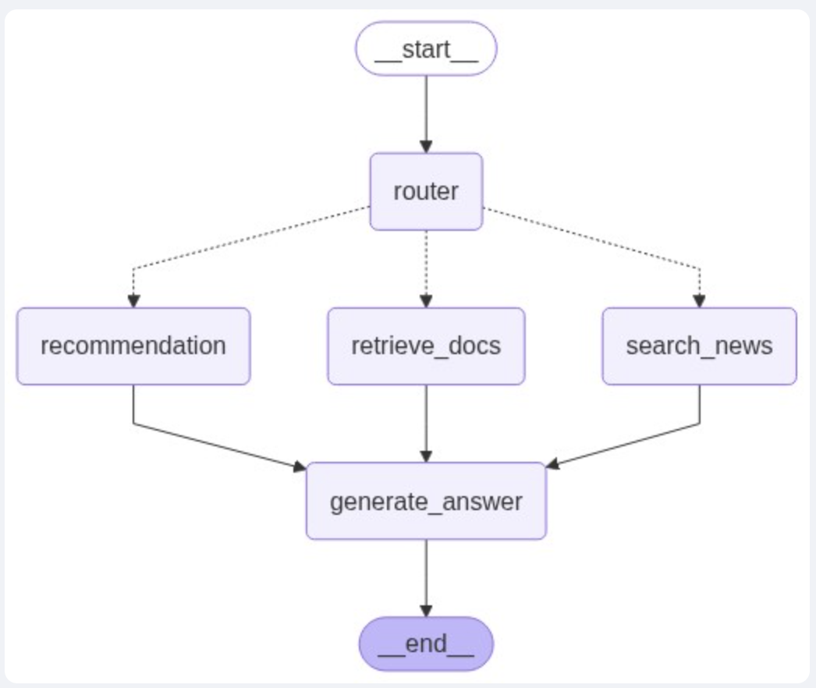
🎯 LangGraph Flow

Slide 8
🎯 Demo Scenarios
Experience the intelligent assistant in action with practical use cases:
Family Car Recommendation
Parts Availability Check
Latest EV News
”News about Tesla model 3?"
"I want to buy a car with a budget of 800 million, which car is suitable?"
"What accessories are currently available for a Toyota Vios?"

Slide 9
🚀 Next Steps & Enhancements
Our roadmap for continuous improvement and expanded capabilities:
Integrate with real-time inventory systems for up-to-the-minute stock data.
Develop a voice assistant interface for hands-free interaction.
Enhance personalization with detailed user profiles and past interactions.
Implement multilingual support, including both English and Vietnamese.
Explore integration with CRM systems for a holistic customer view.

